Slide 1
Unit 2
Lecture 5

Slide 2
How you can start a company ?
Is there any law in India related to companies?
From where we should start ?

Slide 3

COMPANY ACT
Started in→1956. (company act , 1956)
Need →enabled companies to be formed by registration, sets out the responsibilities of companies, their directors and secretaries and also provides for the procedures for its winding
Till a date two new act passed by INDIAN government
Company act 1956→ company act , 2013→ company act 2017

Slide 4
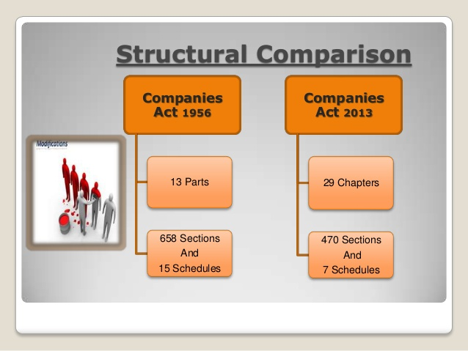

Slide 5
Highlights
Companies Act 1956 explains about the whole procedure of
How to form a company
Its fees procedure,
Name
Constitution,
Its members,
The motive behind the company,
Its share capital,
Its general board meetings
Management and administration of the company including an important part which is the directors as they are the decision makers and they take all the important decisions for the company their main responsibility and liabilities about the company matter the most.
The Act explains about the winding of the business as well and what happens in detail during liquidation period.

Slide 6
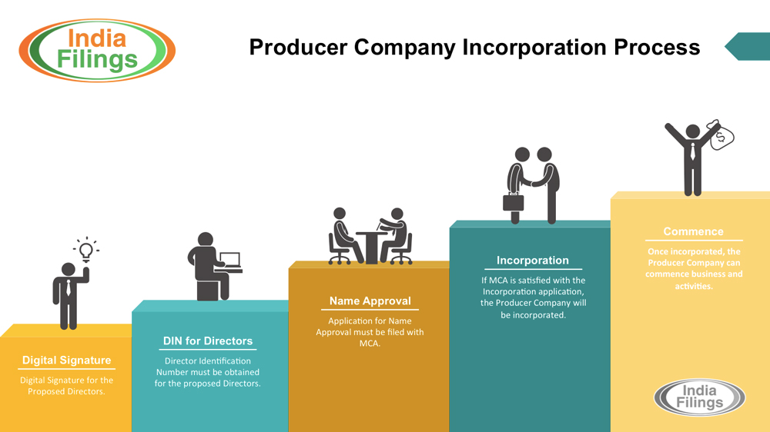
Process to start a company
Notes:
Step 1: DSC
The Information Technology Act, 2000 provides for use of Digital Signatures on the documents submitted in electronic form in order to ensure the security and authenticity of the documents filed electronically
Names of Certification Agency (CA) from where DSC can be acquired are MTNL CA, TCS, IDBRT, SAFESCRYPT (SATYAM), nCODE Solutions, NIC, Central Excise & Customs
Step 2: Acquire Director Identification Number
The concept of a Director Identification Number (DIN) has been introduced for the first time with the insertion of Sections 266A to 266G of Companies (Amendment) Act, 2006. As such, all the existing and intending Directors have to obtain DIN within the prescribed time-frame as notified.
Step 3: Register DSC
Third step is to register DSC of the person authorized to sign E-forms on MCA21
Step 4: Apply for Reservation of Name [S.4(4)]
As per section 4(4) of Companies Act, 2013 read with rule 9 of Companies Incorporation Rules, 2014, application is to be made to registrar for reservation of name. 6 names can be proposed after checking its availability at MCA21 and as per guidelines given in the said rules
Step 5: Drafting and Printing of Memorandum and Articles of Association
After ascertaining name availability from the Registrar of Companies steps should be taken to get the memorandum and articles of association for the proposed company drafted and printed. The memorandum of a company limited by shares shall be in Tables – A in Schedule – I of the Companies Act, 2013.
If the promoters plan to get the securities of the proposed company listed with one or more designated stock exchanges, it is advisable to send the draft of the memorandum and articles of association to those stock exchanges for their scrutiny and suggestion to the effect whether they would like to have certain articles incorporated therein in compliance with the provisions of the Listing Agreements of the stock exchanges.
Step 6: Filing of Company Incorporation form – eform INC 7, DIR 12 & INC 22
As per Rule-12 of Companies (Incorporation) Rules, 2014, application for incorporation of a private and Public company, with the Registrar, within whose jurisdiction the registered office of the company is proposed to be situated, shall be filed in Form no. INC 7 [Rule 12 to 18] along with Form no. INC.22 for situation of registered office of the Company, (as the case selected in form no. INC 7) and DIR -12.
Note:
Form is required to be filed within 60 days as the name is reserved only for this time period.
Stamp Duty is payable online as it exceeds Rs. 100/-
If you have to file INC 22 with INC 7, then:
Step 7: Filing of Commencement of Business – eform INC 21
On registration, a company cannot commence business or exercise any borrowing powers until it files a declaration by directors in Form INC – 21 to the effect hat every subscriber to the memorandum has paid the value of the shares agreed to be taken by them as specified in section 1(1)(a).
E-form INC.21 is required to be filed with concerned Registrar of Companies for obtaining approval for commencement of Business and exercise of borrowing powers. This E-form is required to be filed by all companies incorporated under Companies Act 2013.

Slide 7
Process to start a company
Step 1: DSC
The Information Technology Act, 2000 provides for use of Digital Signatures on the documents submitted in electronic form in order to ensure the security and authenticity of the documents filed electronically
Names of Certification Agency (CA) from where DSC can be acquired are MTNL CA, TCS, IDBRT, SAFESCRYPT (SATYAM), nCODE Solutions, NIC, Central Excise & Customs
Step 2: Acquire Director Identification Number
The concept of a Director Identification Number (DIN) has been introduced for the first time with the insertion of Sections 266A to 266G of Companies (Amendment) Act, 2006. As such, all the existing and intending Directors have to obtain DIN within the prescribed time-frame as notified.
Step 3: Register DSC
Third step is to register DSC of the person authorized to sign E-forms on MCA21
Step 4: Apply for Reservation of Name [S.4(4)]
As per section 4(4) of Companies Act, 2013 read with rule 9 of Companies Incorporation Rules, 2014, application is to be made to registrar for reservation of name. 6 names can be proposed after checking its availability at MCA21 and as per guidelines given in the said rules
Notes:
266. Power of Tribunal to assess damages against lawless directors, etc.
(a) has misapplied or retained, or become liable or accountable for, any money or property of the sick company; or
(b) has been guilty of any misfeasance, malfeasance, non-feasance or breach of trust in relation to the sick company,

Slide 8
Process to start a company
Step 5: Drafting and Printing of Memorandum and Articles of Association
After ascertaining name availability from the Registrar of Companies steps should be taken to get the memorandum and articles of association for the proposed company drafted and printed. The memorandum of a company limited by shares shall be in Tables – A in Schedule – I of the Companies Act, 2013.
If the promoters plan to get the securities of the proposed company listed with one or more designated stock exchanges, it is advisable to send the draft of the memorandum and articles of association to those stock exchanges for their scrutiny and suggestion to the effect whether they would like to have certain articles incorporated therein in compliance with the provisions of the Listing Agreements of the stock exchanges.
Step 6: Filing of Company Incorporation form – eform INC 7, DIR 12 & INC 22
As per Rule-12 of Companies (Incorporation) Rules, 2014, application for incorporation of a private and Public company, with the Registrar, within whose jurisdiction the registered office of the company is proposed to be situated, shall be filed in Form no. INC 7 [Rule 12 to 18] along with Form no. INC.22 for situation of registered office of the Company, (as the case selected in form no. INC 7) and DIR -12.
Note:
Form is required to be filed within 60 days as the name is reserved only for this time period.
Stamp Duty is payable online as it exceeds Rs. 100/-
If you have to file INC 22 with INC 7, then:
Step 7: Filing of Commencement of Business – eform INC 21
On registration, a company cannot commence business or exercise any borrowing powers until it files a declaration by directors in Form INC – 21 to the effect hat every subscriber to the memorandum has paid the value of the shares agreed to be taken by them as specified in section 1(1)(a).
E-form INC.21 is required to be filed with concerned Registrar of Companies for obtaining approval for commencement of Business and exercise of borrowing powers. This E-form is required to be filed by all companies incorporated under Companies Act 2013.

Slide 9
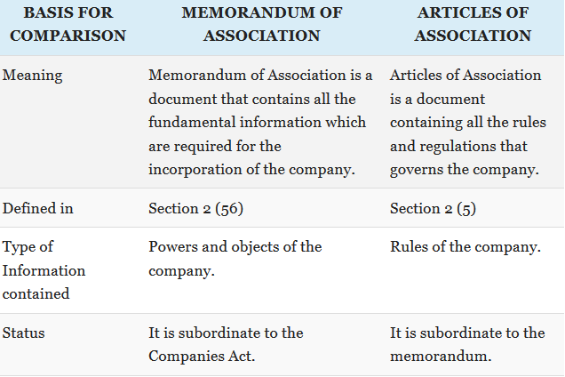
Difference between MOA AND AOA

Slide 10
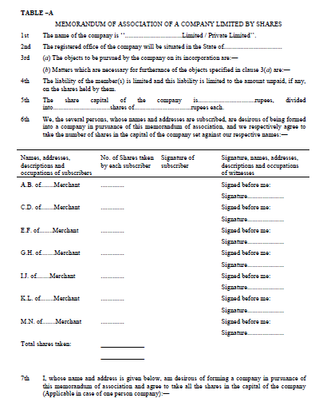
Step 5

Slide 11
Process to start a company
Minimum Requirement of a Private Company:
Minimum 2 Shareholders
Minimum 2 Directors (The directors and shareholders can be same person)
Minimum Authorised Share Capital shall be Rs. 100,000 (INR One Lac)
DSC (Digital Signature Certificate) for all the Directors (for applying of DIN)
DIN (Director Identification Number) for all the Directors
Minimum Requirement of a Public Company:
Minimum 7 Shareholders
Minimum 3 Directors (The directors and shareholders can be same person)
Minimum Authorised Share Capital shall be Rs. 500,000 (INR Five Lac)
DIN (Director Identification Number) for all the Directors
DSC (Digital Signature Certificate) for one of the Directors

Slide 12
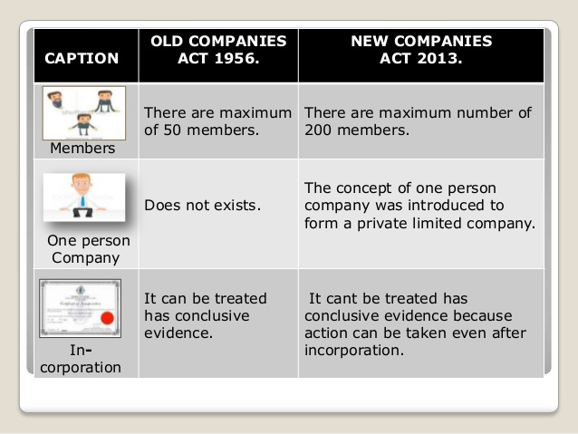

Slide 13
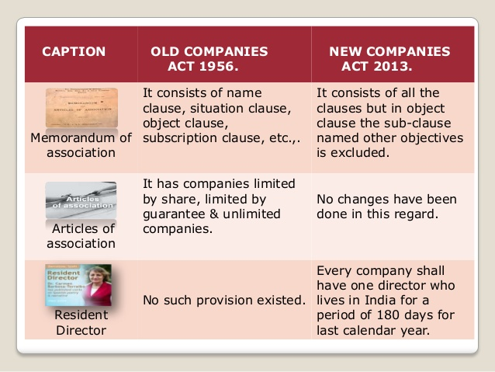

Slide 14
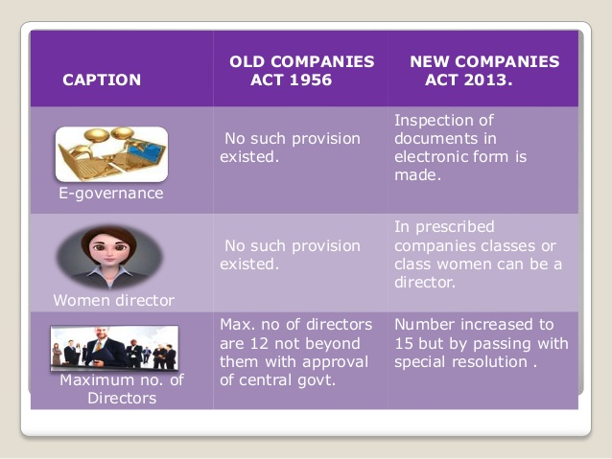

Slide 15
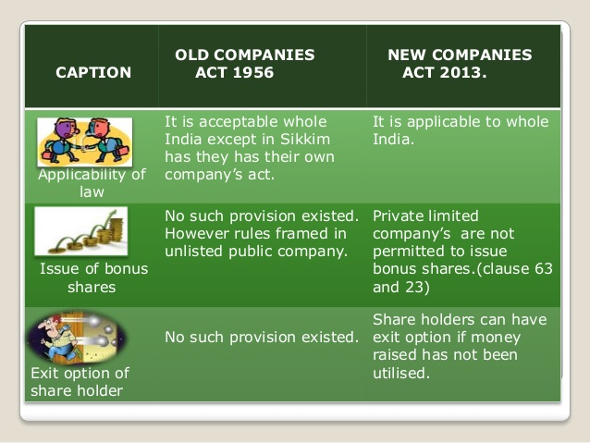

Slide 16
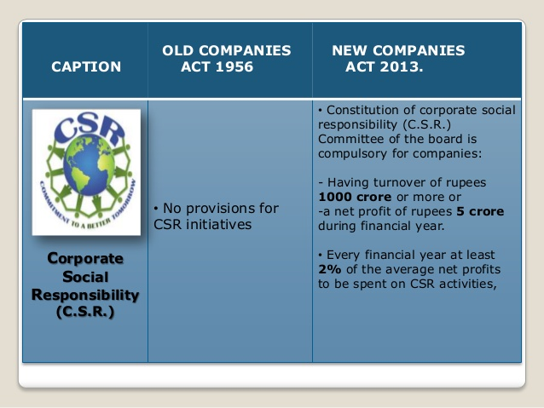

Slide 17
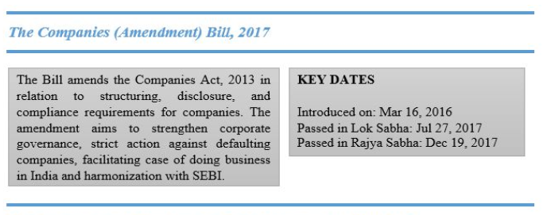
Company act, 2017
Amendment done in 2017
Notes:
From now onwards Director shall not be disqualified under section 164 (2) of Companies Act, 2013 for a period of six months from the date of his appointment.
(section 164(2). (2) No person who is or has been a director of a company which—
(a) has not filed financial statements or annual returns for any continuous period of three financial years; or
(b) has failed to repay the deposits accepted by it or pay interest thereon or to redeem any debentures on the due date or pay interest due thereon or pay any dividend declared and such failure to pay or redeem continues for one year or more,
shall be eligible to be re-appointed as a director of that company or appointed in other company for a period of five years from the date on which the said company fails to do so. 104 )
After this amendment any number provided by Central Government can be treated as DIN.
Associate Company of a Company incorporated outside India from now onwards can apply to Tribunal for a different Financial Year.
For Incorporation of a Company “Declarations” will be required instead of “Affidavits”.
Along with Directors and KMP, any employee of the Company can authenticate the Documents.
Annual Return extracts i.e. MGT-9 can now be placed on the website.
Form MGT-14 with respect to 180 (1) (a) (c) is no more required to file with ROC.
Filing of Form DIR-11 i.e Resignation of Director is now optional.
Form MGT-10 with respect to change in promoters and 10 top ten shareholders shareholding is not required to file with ROC.
Central Government approval is no more required for payment of remuneration in excess of 11% of net profits. It means it can be passed by passing Ordinary Resolution.
Annual General Meeting of Unlisted Company may be held at any place in India if the consent is received in advance from all the members.
New format for Private Placement offer-cum application may be issued by the Government.
Wholly owned subsidy of foreign Company can hold EGM outside India also.
Disclosures included in Financial Statements already, need not to be repeated in Board Report.
If Company defaults in filing of Return of Allotment (PAS-3) beyond 15 days then Co., its promoters and Directors are liable to pay penalty of Rs. 1000 per day subject to maximum of Rs. 25 Lacs.
Associate company of a company incorporated outside India can also apply to the Tribunal for a different financial year.
For CSR Net worth/ Turnover/ Net Profit shall be considered for immediately preceding Financial Year instead of 3 preceding year.
Notice of every change of shifting of Registered Office (E-Form INC-22) is now required to file with ROC within 30 days instead of 15 days.
If a Director is disqualified u/s 164 (2) of Companies Act, 2013 then he will to vacate his office from All Companies except that the Company which is in default.
Abridged version of Annual Return for OPC & Small companies shall be prescribed.
In addition to Nidhi Companies, Mutual Benefit Society can also be registered under Chapter XXVI of the Act.
Wholly owned subsidy of foreign Company can hold EGM outside India also.
Financial Statements for Joint Ventures shall not be Consolidated with the Financial Statements of the Company.
Return of Allotment (PAS-3) shall be filed within 15 days of Allotment instead of 30 days.
From now onwards CEO of the Company shall sign the Financial Statements of the Company.
Annual General Meeting of Unlisted Company may be held at any place in India if the consent is received in advance from all the members.
Disclosures included in Financial Statements already, need not to be repeated in Board Report.
Partnership Firm, LLP, Societies etc. may convert itself into a Private Company with 2 or more members only. (Earlier at least 7 members was required).
Now the Company to have at least one Resident Director who stays in India for a total period of 180 days during the Financial Year instead of Calendar Year.
Sweat Equity Shares can now be issued at anytime, hence no need to wait for one year from commencement of business.

Slide 18
NASSCOM

Slide 19
TRADE ASSOCIATION
an organization founded and funded by businesses that operate in a specific industry.

Slide 20
NASSCOM
The National Association of Software and Services Companies (NASSCOM) is a trade association of Indian Information Technology (IT) and Business Process Outsourcing (BPO) industry.
Established in 1988, NASSCOM is a non-profit organisation.
Vision:
To help the IT and IT enabled products and services industry in India to be a trustworthy, respected, innovative and society friendly industry in the world.

Slide 21
Headquarters
NASSCOM is a global trade body with over 2000 members, of which over 250 are companies from China, EU, Japan, the U.S. and the UK.
NASSCOM's member companies are in the business of software development, software services, software products, IT-enabled/BPO services and E-commerce.
NASSCOM is headquartered in New delhi(Noida), India, with regional offices in the cities of Bengaluru, Chennai, Hyderabad, Kochi, Kolkata, Mumbai, Pune and Thiruvananthapuram.

Slide 22
FUNCTIONS OF NASSCOM

Slide 23
Partnership with the government
NASSCOM acts as an advisor to the Indian government at the centre as well as state levels. With adequate representation in various ministries of the government, the organization ensures that the government frames industry friendly policies. It also forms partnerships at the global level for promoting the Indian IT and ITES industries

Slide 24
Protection of Intellectual Property Rights
The organization is a strong proponent of intellectual property rights. It supports software anti piracy by setting up hotlines and facilitating law enforcement.

Slide 25
Research on IT and ITES
NASSCOM conducts in depth research on the IT and ITES industries to keep its members well aware of the global trends, best practices, threats and opportunities.
IT companies are those which do projects related to programming , testing , database and other project related works
ITES as a form of outsourced service which has emerged due to involvement of IT in various fields such as banking and finance, telecommunications, insurance, etc.

Slide 26
Support for quality products and services
NASSCOM encourages its members to maintain high quality of products and services with the aim of developing global public confidence for its members and the industry. It also helps the members achieve international quality certifications through regular seminars and workshops on quality standards.

Slide 27
Talent Pool in India
India has one of the largest talent pool in the world with 300,000 engineers and 2.1 million graduates being produced by its 11,200 higher education institutions each year. NASSCOM ensures that the quality and quantity of professionals in the country increases with time and that the country is able to cater to the global demand of IT and ITES outsourcing services

Slide 28
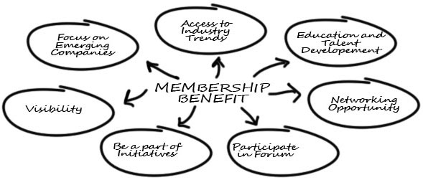

Slide 29


Role
Industry Development
As the industry has expanded into multiple sub-sectors, NASSCOM has built an Industry Council structure that addresses the needs of the specific sector. Focused programs, research, events, industry initiatives are implemented through Industry Councils.

Slide 30




Ex: IT Services Council
With the advent of digital technologies, traditional businesses are being disrupted with technology central to this transition.

Slide 31
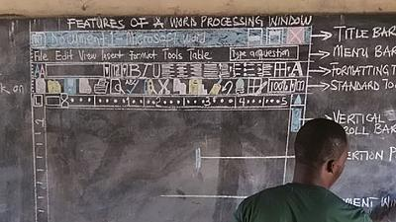
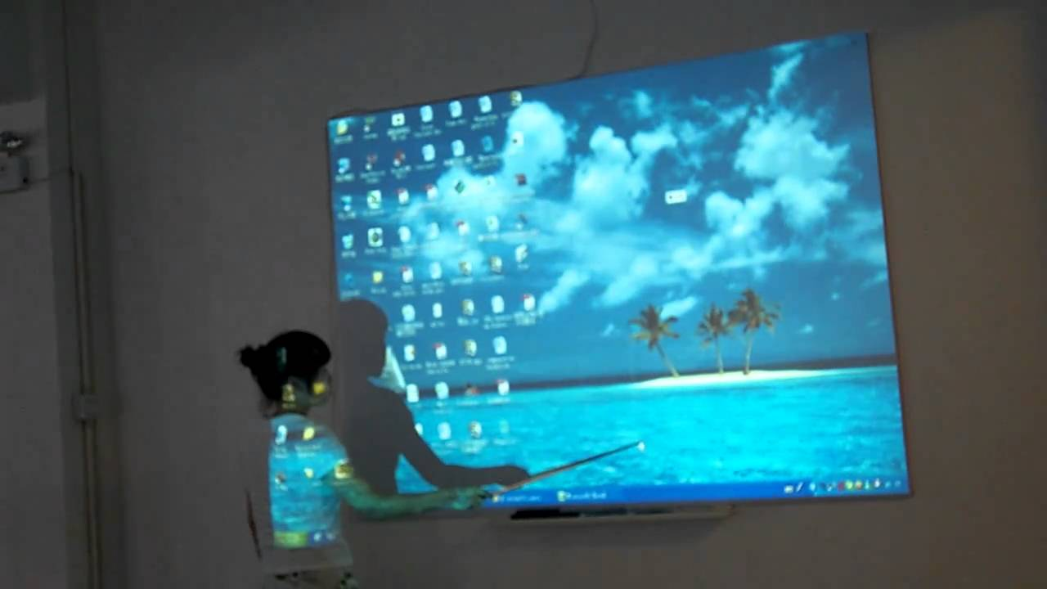

Slide 32
By 2025, it is expected that the total addressable technology market would have grown to almost $ 4 trillion – however with one big difference.
Almost 80% of this incremental spends on technology will be driven by digital technologies including mobile systems, social media, cloud, analytics, machine to machine, cyber security and integration platforms to connect these to legacy systems.
How will the Indian IT services industry react to this opportunity?
NASSCOM has constituted a cross section of senior industry executives, forming the IT Services and Solutions Council, to address the needs of this industry during this inflection time.

Slide 33
Ex: Internet, Mobile and E-Commerce Council
The number of internet users in India have surpassed 400 million mark, making it the second largest market after China. Increase in internet penetration in India has also led to the exponential growth in e-commerce sector in India.
With an annual growth of around 20%, it is estimated that the e-commerce industry will surpass $ 100 billion mark by 2020.

Slide 34


New emerging fields like Internet of Things (IoT) are thriving on the success of internet and has started revolutionizing various sectors such as manufacturing, energy, transportation, medical, health care etc.
Globally IoT market is expected to cross $300 billion by 2020 and India aims to capture 20 percent of its market share by this time.
Notes:
In the past decade India has witnessed a tremendous growth in Internet and E-commerce space.

Slide 35
STPI

Slide 36

Software Technology Parks of India(STPI) , is an Autonomous Society set up by the Ministry of Electronics and Information Technology(MeitY), Government of India in 1991.
OBJECTIVE- to encourage, promote and boost the Software Exports from India.
STPI maintains internal engineering resources to provide consulting, training and implementation services.
Services cover Network Design, System Integration, Installation, Operations and maintenance of application networks and facilities in varied areas.
Software Technology Parks of India centre also adhere to ISO 9001 certification.
Notes:
. It is an export oriented scheme for the development and export of computer software, including export of professional services. The process development of STPI is in accordance to the Quality Management System, and adheres to ISO 9001 certification

Slide 37
The STP Scheme provides various benefits to the registered units, including 100% foreign equity, tax incentives, duty-free import, DTA entitlement, and deemed exporting.
HISTORY- Software Technology Parks of India was established and registered as an Autonomous Society under the Societies Registration Act 1860, under the Ministry of Electronics & Information Technology, Government of India on 5th June 1991 with an objective to implement STP Scheme, set-up and manage infrastructure facilities and provide other services like technology assessment and professional training.

Slide 38
International Communication is one such factor which needed much attention and India was factored -2 as against +8 factored to Ireland.
This is one of the primary reasons why STPI took up the responsibility of improving the International Data Communication facilities exclusively for the Software Export Industry.
Even though the intention was not to become an International Carrier, but because of the better quality of service provided by STPI and with a high rate of acceptance from the Industry, STPI's International Data Communication Services have grown much beyond anybody's imagination.
STPI has truly emerged as an unconventional International carrier within a short span of time and developed relationships with 26 International carrier companies worldwide.

Slide 39
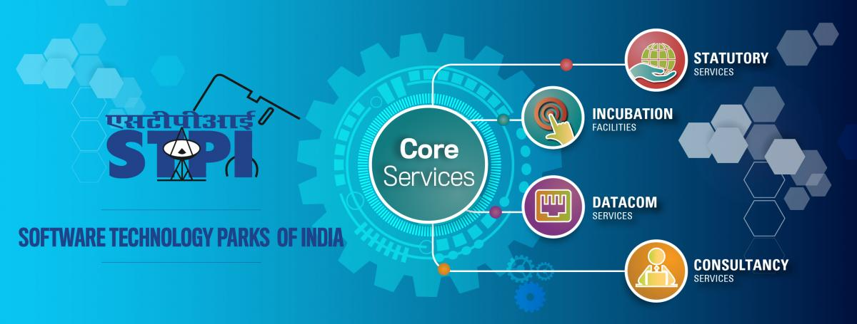
Notes:
DATACOM services :- STPI is one of the first Internet service provider (ISP) license with operational jurisdiction covering all of India. STPI provides leased-line services to the premium segment where quality is of utmost concern.
STPI’s national service delivery and management infrastructure includes 52 independent gateways, huge quantities of international bandwidth on international fiber and satellites, a state-of-the-art Network Operations Centre (NOC), comprehensive Network Management Systems (NMS), a data centre, and a Disaster Recovery (DR) site.

Slide 40
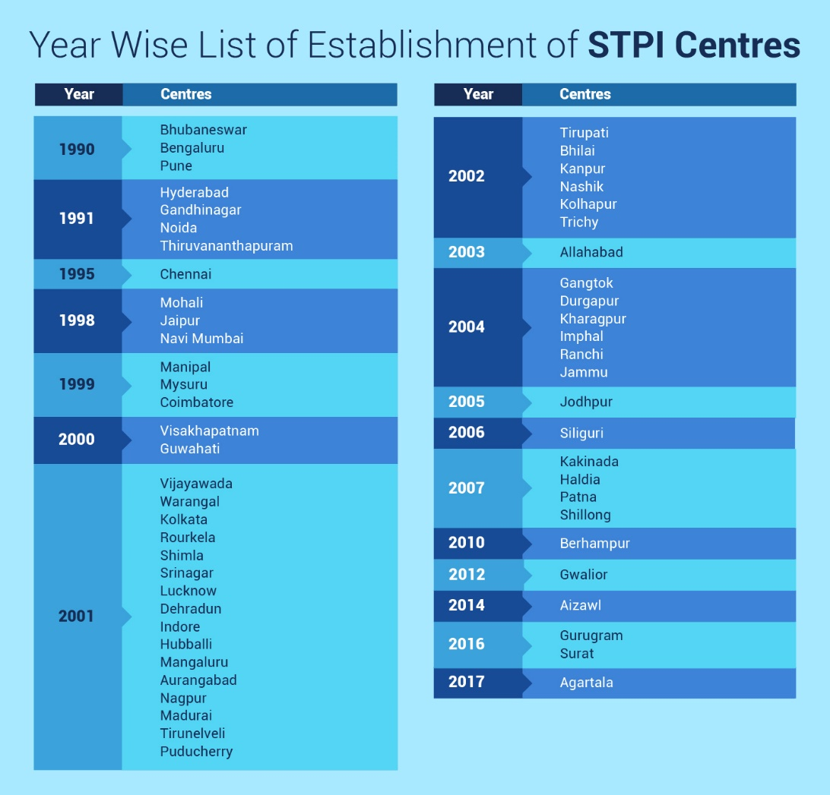

Slide 41
Objectives of Software Technology Parks of India
(a) To promote the development and export of software and software services including Information Technology (I.T.) Enabled Services/ Bio-IT.
(b) To provide statutory and other promotional services to the exporters by implementing Software Technology Park/ Electronics and Hardware Technology Park Schemes and other such schemes which may be formulated and entrusted by the Government from time to time.
(c) To provide data communication services including value added services to IT / IT Enabled Services related industries.
(d) To promote micro, small and medium entrepreneurs by creating conducive environment for entrepreneurship in the field of IT / IT Enabled Services.

Slide 42
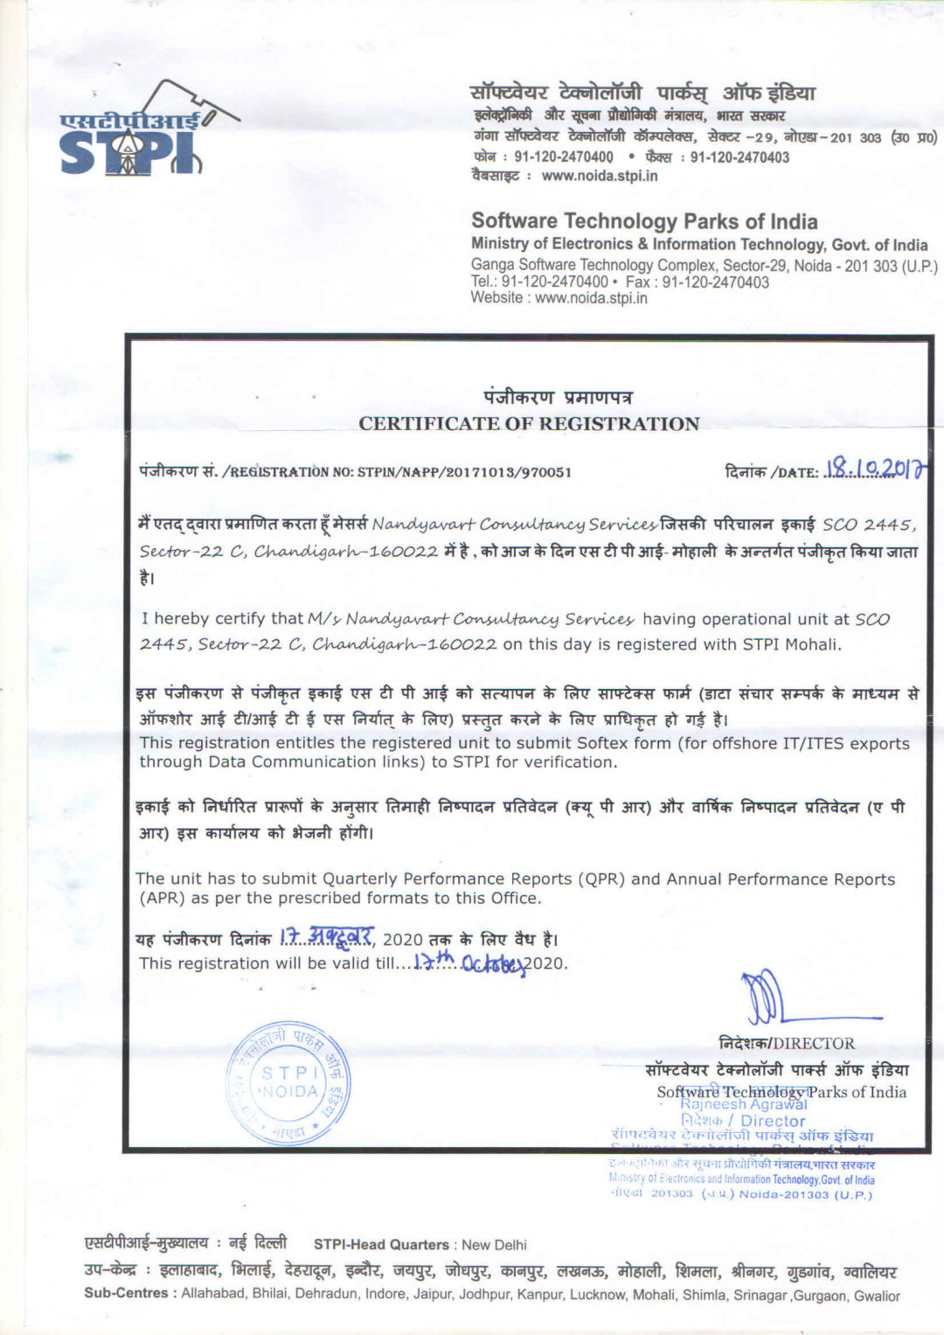

Slide 43
Functions of Software Technology Parks of India

Slide 44
(1) To establish Software Technology Parks / centres at various locations in the country-
(a) to perform all functions in the capacity of the successor to the erstwhile Software Technology Park Complex which were taken over by the Software Technology Parks of India
(b) to establish and manage the infrastructural resources such as integrated infrastructure including International communication / Data center / Incubating facilities etc. for 100% export oriented units and to render similar services to the users other than exporters.
(c) to undertake other export promotional activities such as technology assessments, market analysis, market segmentation as also to organize workshops/exhibitions/seminars/conferences etc.
(d) to facilitate specialized training in the niche areas to meet the above objectives.
(e) to work closely with respective State Government and act as an interface between Industry and Government.

Slide 45
(f) to promote entrepreneurship through incubation programmes / seed funds / IP development and other awareness programmes.
(g) to assist State Governments in formulating IT policies and liaison for promoting the IT industries in respective states to achieve an exponential growth of exports.
(h) to promote quality and security standards in the I.T industries.
(i) to work jointly with venture capitalists for providing financial assistance to the IT industries.
(j) to provide Project Management and Consultancy services both at national and international level in the areas of expertise of Software Technology Parks of India

Slide 46
(2) To perform financial management functions which comprise of the following activities;
(a) to obtain or accept grants, subscription, donations, gifts from Government, Corporations, Trusts, Organizations or any person for fulfilling the objectives of the Software Technology Parks of India
Note: Whenever any gifts from foreign Governments/ organizations are accepted / obtained they shall be routed through Government and be regulated by such directions as may be issued by Government.
(b) to maintain a fund to which shall be credited:
-all money provided by Central Government, State Governments, Universities etc.
-all fees and other charges received by the Software Technology Parks of India .
-all money received by the Software Technology Parks of India by way of grants, gifts, donations, benefactions, bequests or transfers; and
-all money received by the Software Technology Parks of India in any other manner or from any other source.

Slide 47
(c) to deposit all money credited to the Fund in Scheduled Banks / Nationalized Banks or to invest in such a manner for the benefit of the Software Technology Parks of India as may be prescribed.
(d) to draw, make, accept, endorse and discount cheques, notes or other negotiable instruments and for this purpose, to sign, execute and deliver such assurance and deeds as may be necessary for the purposes of the Software Technology Parks of India
(e) to pay out of the funds maintained by Software Technology Parks of India or part thereof, the expenses incurred by the Software Technology Parks of India from time to time including all expenses incidental to the formation and reorganization of the Software Technology Parks of India and management and administration of any of the foregoing activities including all rents, rates, taxes, outgoings and the salaries of the employees.
(f) to acquire, hold and dispose of the property in any manner whatsoever for the purposes of the Software Technology Parks of India, with the prior approval of Governing Council as per the procedure laid down by Government.
Notes:
(c) At least 60% of the funds shall be placed with the Public Sector Banks or in such a manner as may be prescribed by the Government from time to time.

Slide 48
PRODUCT BASED COMPANIES
VS
SERVICE BASED COMPANIES
UNIT 2

Slide 49

SERVICE COMPANY
They fulfil software requirements for a client.
Examples of a service-based company are TCS, Infosys and Wipro
Statement :-

Slide 50

PRODUCT COMPANY
They fulfil product requirements of the general consumer.
Product-based company examples are Microsoft, Google and Yahoo,amazon.
Statement:-

Slide 51
CASE STUDY OF SERVICE BASED COMPANY (TCS)
TCS’ offerings include application development and maintenance, business intelligence and business process services. TCS employs more than 285,000 professionals in 44 countries and in FY13 generated annual revenue of US$11.6 billion. In 2005, TCS created TCS IT Infrastructure Services (TCS-IT IS) to help businesses develop infrastructure that improved revenues, facilitated cost management and delivered better customer service. TCS-IT IS is growing at 30% annually and generates more than US$1 billion in revenue each year.

Slide 52
The Challenge(TCS)
In 2009, TCS-IT IS noticed that businesses around the world were adopting on-demand access to third-party infrastructure. rather than investing in on-premise servers, storage and networking equipment TCS-IT IS found many of these businesses wanted to extend this model to access applications such as enterprise resource planning as part of an integrated solution stack—comprising hardware, networking, software and services—from a third-party provider. TCS-IT IS started addressing this need by delivering infrastructure and applications as a service from its datacentres to small businesses in industries such as healthcare, education, retail and manufacturing
What exactly a problem that is faced by a company ?
How can they solve the problem?

Slide 53
OPTION AVAILABLE TO COMPANY
In 2010, TCS-IT IS decided to develop a cloud service that would extend its multi-tenant datacentre offerings to larger businesses. The proposed India Cloud Platform (ICP) would allow businesses of all sizes to access infrastructure and applications from the cloud.
TCS-IT IS wanted the ICP to scale easily, enable new customers to be added quickly and keep sensitive information secure. The ICP would also complement TCS-IT IS’ consulting services, which businesses could use to ensure their data in the cloud complied with internal policies and governance regimes, as well as external regulations.
What type of option is available with company and how it is beneficial for them ?
Notes:
“We wanted to build a shared services platform that enabled the logical separation of customers’ applications and data,” said Mahesh Menon, Head – TCS-IT IS India Cloud Platform. “We needed a partner that could meet these requirements, while helping us manage the cloud platform as efficiently and cost-effectively as possible.”

Slide 54
The Solution
After reviewing its options, TCS-IT IS decided to implement VMware datacentre virtualization for the first stage of the ICP project.” said Menon.[1]
In 2011, TCS-IT IS began ramping up from a multi-tenant datacentre to a full cloud service and conducted a more comprehensive evaluation of the virtualization market. This included completing proofs of concept with two technology providers headquartered in the United States.
“With one of the providers, we couldn’t mix and match data storage types,” said Menon. “We needed this because our existing storage area network did not have the capacity on its own to manage our workloads. “We also found that the products supplied by the other vendors were far behind in providing centralized management over a single console.”
At this time, VMware was finalizing a new release of VMware vSphere® and briefed TCS-IT IS on features that made it easier to provision physical and virtual machines, enforce security and compliance, manage networks and control traffic flows. “We opted to stay with VMware because of its technical superiority and our comfort with the technology,” said Menon.
“When it came to this stage of the project, we wanted to ensure that our choice of platforms and technologies was right, and that we could support a range of usage scenarios,” said Menon. “We selected VMware PSO to undertake the deployment so we could draw on the team’s experience and expertise,”[2]
Notes:
This involved extending the services available through TCS-IT IS’ multi-tenant datacentre environment. “We went with VMware because of the abundance of skill and knowledge about the vendor’s virtualization technologies in the marketplace, and the fact no other product was as mature,
VMware PSO used well-established techniques and practices to train 10 TCS-IT IS consultants in running the platform. “The PSO team’s knowledge transfer was excellent and our consultants are now skilled in helping customers achieve value from the TCS-IT IS India Cloud Platform,” said Menon. Thanks to VMware PSO, TCS-IT IS is now running more than 2,000 virtual machines on 80 servers at a ratio of 25:1 to deliver the cloud platform.This high density has helped TCS-IT IS extract considerable value from its hardware investments.

Slide 55
Business Results & Benefits
VMware vSphere—combined with technologies from Cisco, HP and NetApp—has enabled TCS-IT IS to provide cloud-based infrastructure services that meet the needs of businesses of all sizes.
“The ICP is a modular, scalable and configurable cloud platform that gives Indian businesses the benefits of increased efficiencies, faster go-to-market, market-leading technologies; predictable spend, IT talent on call and better business results,” said Menon.
ICP customers pay monthly or quarterly to access infrastructure on demand rather than investing several hundred thousand dollars in on-premise datacentre equipment. This gives them greater certainty over costs and enables more accurate budgeting.

Slide 56
Taking reference of this case study explain the need of Decision making in company

Slide 57

CASE STUDY OF PRODUCT BASED COMPANY (Amazon’s Echo)

Slide 58

“Alexa is my new BFF”: A Case Study of the Amazon Echo’s Use by companies and common man.

Slide 59
“Alexa, tell me the future of radio!”
Amazon’s Alexa voice-controlled environment. Alexa exists in an audio-centric world, performing a variety of tasks in response to voice commands. And her integration into Amazon’s family of wireless speakers, including Echo, allows Alexa to play out live radio and on-demand audio content, serving as a hub for entertainment and information.
The radio industries in the US and UK, in particular, have been quick to get friendly with Alexa, marking the start of a new voice-activated journey for the medium, a journey that may eventually change the way we interact with radios in cars, at home and on the move.

Slide 60
Why companies are taking interest in ALEXA.
Alexa has music at her heart, with TuneIn (the default radio service), Spotify Premium, iHeartRadio and – naturally – Amazon’s own Prime Music among a number of supported services. Sensing an opportunity to build a presence in this new audio environment, the UK radio industry has made a fast entry to the fray, through its market-level UK Radioplayer platform. Radioplayer is available as an Alexa skill (Amazon’s name for the environment’s apps). When enabled, Radioplayer gives voice-controlled access to more than 450 radio stations from around the UK, allowing users to start a station by name or by recommendation based on location, what’s popular at the time or on past listening. The integration is the result of a close cooperation between Radioplayer’s R&D team and Amazon. Ensuring seamless functionality across the whole country required all of the radio stations names to be pre-recorded in a variety of regional dialects, and this attention to detail seems to have paid off in terms of a smooth user experience, according to reviews, making the Radioplayer skill more effective in selecting the right station than, for example, the default TuneIn skill. “We’ve been prototyping voice-controlled interfaces, but the Echo is by far the most capable device we’ve seen” commented Michael Hill, Radioplayer’s Managing Director, in a press release announcing the launch. “Voice interfaces will play a huge part in car dashboards and home automation devices, and they can help people with impaired vision and mobility too.
Notes:
Alexa, and other similar services such as Google Home, may not have come to your market at scale yet, but voice-controlled technology is becoming increasingly important. As these innovations start to bring more and more marketers’ attention – so long focused on the visual world – back to audio, this is an opportunity radio cannot afford to miss!

Slide 61
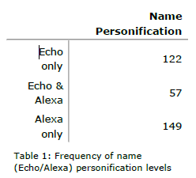
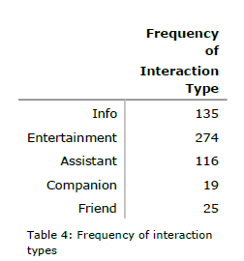
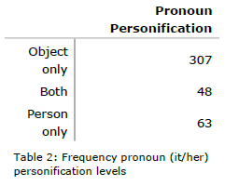
Interest of General public in ALEXA
“My entire family enjoys Alexia! This device is in the center of our home! She keeps our grocery list, many reminders, plays all of our favourite playlists, orders amazon items, wakes us up, tells us when its time to leave, adds events to our calendars, and much more!”

Slide 62
Question
Why this type of social conversational agents
are that much popular.
How companies are taking advantages from them.
Big question! Is it good for Human or question to our existences . If yes/ No then why?

Slide 63
Why Companies are concerned for Virtual assistant.
50% of all searches will be voice searches by 2020.
By 2019, the voice recognition market will be a $601 million industry.
40% of adults now use voice search once per day.
19% of people use Siri at least daily.
Mobile voice-related searches are 3X more likely to be local-based than text.
28% think Voice Search is a more accurate way of searching.

Slide 64
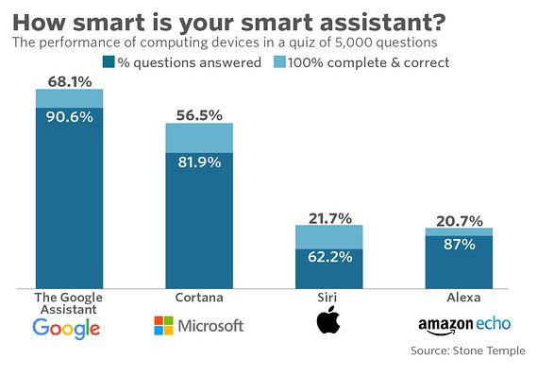

Slide 65
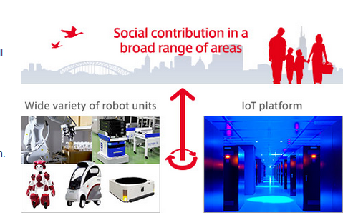
New advancement
Hitachi’s robotics contributes to society in various areas
Hitachi develops a wide variety of robots integrated with an IoT platform to improve people’s lives.

Slide 66
EMIEW3
EMIEW3 is a human symbiotic robot that aggregates data obtained from various external sensors.
Information necessary for providing services is then processed over a cloud-based robotics IT platform and fed back to the robot – helping it navigate, communicate, and interact with its surroundings.
This IT infrastructure can also be integrated with existing operational systems to provide business intelligence by processing various kinds of relevant information. We also offer business solutions with interconnected robots.

